Slide 1


^{www.nabdsolutions.com}

Slide 2

Who AM I ? → Fact Sheet
Highlights:
Ali Bawazeer @AliBawazeEer
Currently in love working as SRT/EMEA Offensive Security Engineer with Synack in - The Premier Security Testing Company
Own NABD Solutions Co as part time
PKI / Payment Specialist and wear multiple hat In security industry
Luckily Worked in different industry – ( I have seen good and bad side )
Not Good at all in sending messages but love to meet people ☺

Slide 3
STORY → what happen ? What is Role of Software
Who is Responsible of Applications Around ?
What happen behind scene ?
Notes:
What is the role of software today ?
Everything in our life become matter of software , food delivery , hospital …etc the take away home – we can’t live
Consumer will not pay high price for something secure ?
Responsibility of developer
* Who wanted Seat Belt ?
Insurance company →

Slide 4
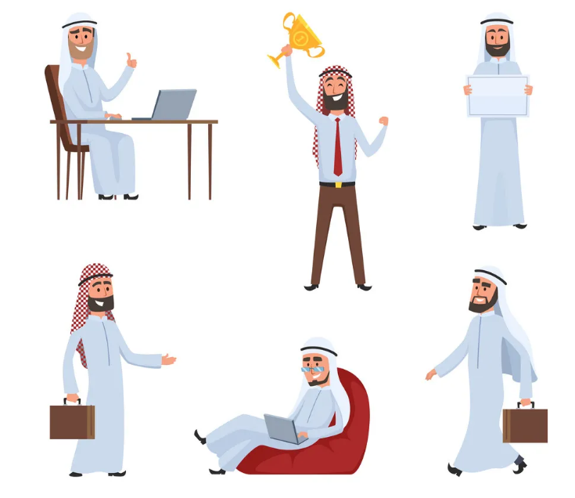
سعدون – حتوته خرافيه تقنية
Book Keeper /Accountant !
Use Cloud Solutions for accountant
Technology Fan / Photographer
Love Crypto Currency
Send a lot of PDF Reports
Notes:
قصة سالم سالمين سلوم زي اي واحد مننا عنده وظيفة , عائلة , وهوايات
سالم , جاته شغله فري لانس عند عميل وراح يشوف حساباته زيه زي اي محاسب عادي بس في مدينة ثانية قبل كرونا بكم يوم وصله الطلب من العميل في ملف بي دي ف فيه حسابات السنة والقوائم المالية
فتح الايميل وقرر يزور العميل في مقره حتى ياخذ وقت اقل مع الfinancial team
خش موقع التذاكر عشان يحجز تذاكر الطيران ببطاقة البنك تبعه – وصل له ملف بي دي ف
سالم عنده برنامج محاسبي في الكلاود يحب يستخدمه لعملائه – يحفظ كل التقارير وين مايكون – خلف الكواليس – الشركة كانت مخترقة من APT Group وبدو ينشرو الmalicious documents باسم الشركة
طبعا سالمين لمن وصل الرياض فىح اللاب توب ودخل الموقع وبدا بعداد التقارير
سالمين انسحبت فلوس من بطاقته وصار يشتكي للبنك وكلفته المكالمات حق المطالبات مبالغ مالية
سالمين بدون علم متحمس في بيتكوين وفضل الكريبتو على المعاملات البنكية وخش يسوي له محفظة ووصل له المفتاح في ملف بي دي ف
سالم سالمين في حوسه الحين فلوسه مارجعت ويبي يشتري كريبتو في نفس الوقت حمل تقارير العميل وصاير يرسلها عن طريق الايميل
شركة البرنامج المحاسبي مخترقه وايضا انسرقت بطاقته مرة ثانية
الشاهد في الموضوع صار اكشن مابين مشاكل تقنية في الشركة الي يتعامل معاها و البنك و حجوزات فنادق تم دفعها
كيف سالم سالمين سلوم يعرف من وين المشكلة ؟ ؟

Slide 5
What Happen behind the scene ?
Did “سعدون” Open any malicious email
Did he click any malicious link ?
Was there any attachment from his client ? PDF attachment
Did he reply to email with PDF documents ?
Does he trust the cloud account solutions he is using ?
Were HOTELS data being compromised or Salem Computer got hacked ?

Slide 6



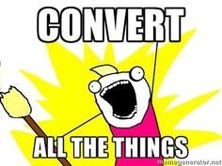
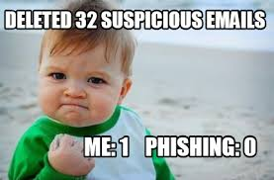
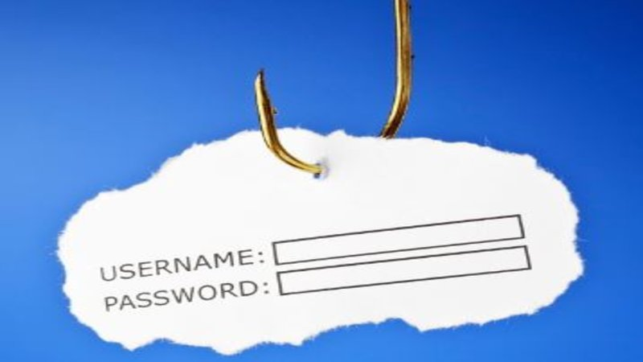
Why PDF ?
Digital Transformation – COVID-19
Everyone Receive Phishing emails
- Anyone never received phishing emails ?! I bit you not
MITRE ATT&ACK
Threat actor uses PDF as Malicious File
https://attack.mitre.org/techniques/T1204/002/
User Execution: Malicious File
User Execution: Malicious Link

Slide 7
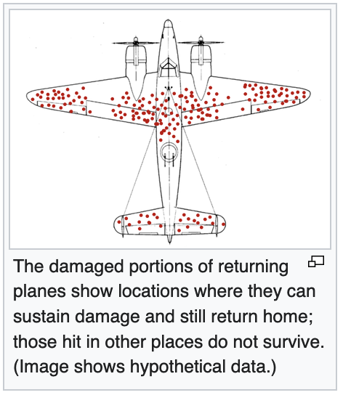
What's a MITRE with your Security?
Notes:
we've latched onto a flaw in operationalizing security with the classic example of survivorship bias. We need to break this cycle to proactively detect new threats.
Matt believes that with MITRE ATT&CK you can take a lot of the opinions about what needs to be logged out of the conversation and focus on the heart of what's important to you and your organization.
أثناء الحرب العالمية التانية الحلفاء حبّوا يشوفوا الثقوب اللى الرصاص عملها فى الطيّارات بعد ما رجعت للمقرّ عشان يعرفوا أكتر أماكن بينضرب فيها رصاص ويحصّنوها كويس، المهم طلعوا بالصورة اللى قدامك اللى بتبيّن أماكن ثقوب الرصاص اللى الطيّارة بترجع بها، ‏وبناءاً على البيانات اللى فى الصورة كانت أول حاجة جت فى تفكيرهم إنهم يعزّزوا المناطق اللى متعلّمة بأحمر بما إنها أكتر أماكن مُعرضة للضرر وراح تخلي الطيارة تسقط ، وهذا تفكير منطقى فعلاً لكن في عالم الرياضيات"أبرهام والد" انتبة من حاجة مهمة وهى إن النقاط الحمراء تمثل الأضرار ‏اللى لحقت بالطيّارات اللى عادت من الحرب بس ،لكن هما ناسيين الطيارات اللى ما رجعت وسقطت عشان كذا المفروض يجمّدوا الأماكن اللى ما فيها نقط حمراء لإن هذي الأماكن اللى راح تخلي الطيارة تسقط لو انضربت فيهم عشان كذا باقي الطيّارات ما رجعت،
الظاهرة اسمها " survivorship bias" ‏أو إنحياز البقاء وهذي مغالطة منطقية واللى معناها ببساطة إننا ننظر على طرق تهديد معينة أو حاجات نجت وننسى أو ما ننتبه من حاجات ثانية ما نجت وبُناءاً عليه استنتاجنا يكون غلط.

Slide 8
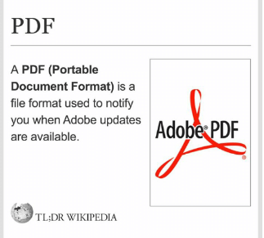
What IS PDF?
This is what everyone knows :
So Many Readers; Browser , Adobe , Foxit ..etc
A lot Of CVEs around internet and many might be used by APT (Advance Persistence Threat)

Slide 9
Why Do we need to inspect PDF Files ?
Nobelium : use decoy PDF files in a phishing campaign
Lyceum APT Group : use decoy PDF files with the Russian-Ukrain war theme
Transparent Tribe : hacker attack Indian officials using Covid them decoy pdf
Muddy Water: Hacking group Targets Turkey in new Campaign
Notes:
Nobelium , a group behind old attack of solarwinds

Slide 10
What might be new – PDF Format
Text Based Structure , PDF files usually contain non-ASCII data
Uses stream to store the data and hierarchal structure
4 Main Parts :
Header ( Signature , identifier of a PDF file %PDF- )
The Body
Cross Reference table
Trailer
Notes:
It also could contain links , video , images

Slide 11
The Body
streams : enclosed between (stream...endstream)
Arrays : enclosed with square brackets([..])
Dictionaries : indexed by names enclosed within double angle brackets <<...>>
Names : starting with a forward slash /
Strings : enclosed within parentheses(()) or as hex within single brackets<>
objects : top level object (1 0 obj...end obj)
- Reference another object (5 0 R)

Slide 12
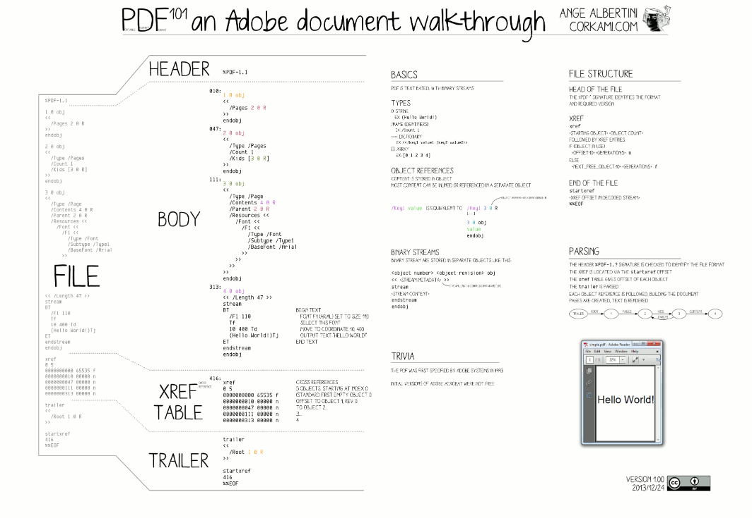

Slide 13
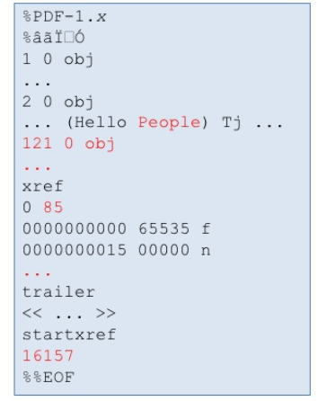
STRUCTURE OF PDF FILE
A PDF file consist of a collection of objects
A PDF files starts with %PDF-1.x and ends with %%EOF
you can use software to change the content of a PDF document: change a stream, add objects

Slide 14

Attack Vectors & Techniques
Phishing attacks
Credentials stealing
Installing backdoors
Setting Persistence
How ?
Link to Malicious sites
JavaScript
Exploit PDF Reader's Vulnerabilities
Embedded streams and files within the PDF

Slide 15


Slide 16
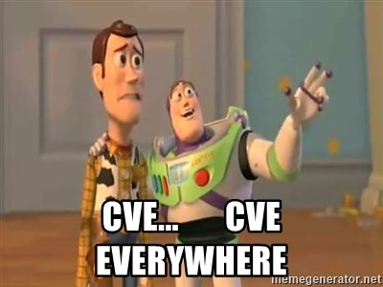
Remote Code Execution – PDF (CVE)
2018-9948
https://www.exploit-db.com/exploits/44941

Slide 17


Slide 18
Stealing Credentials
Example(1) : ebb5492584d29b3247b6138b866ddda2
Name: bank_statement.pdf
Techniques :
Phishing - JavaScript (Stealing Credentials)

Slide 20


Slide 21
More Sophisticated Techniques
Demo Dissecting PDF file used by

Slide 22
Analyzing PDF Files
Very popular format in today life == Tons of file to analyze
Different PDF Readers == Lots of exploits (CVE – RCE = Click Full compromise)
Static Analysis Vs Dynamic Analysis

Slide 23
Key Consideration when working with Malwares
Always use a virtual environment – or disconnect sandbox < recommend using Remnux Distribution) shipped with malware analysis tools
Capitalize on publicly available tools such as
Virustotal – Yara Rules
https://any.run
https://www.hybrid-analysis.com/

Slide 24
Static Analysis Tools |
Tools helpful to statistically analyze PDF documents:
PeePDF __________.pdf
pdf-parser __________.pdf
pdfextracts __________.pdf
Curious convert to JPEG | Non-exhaustive list of possible conversion

Slide 25
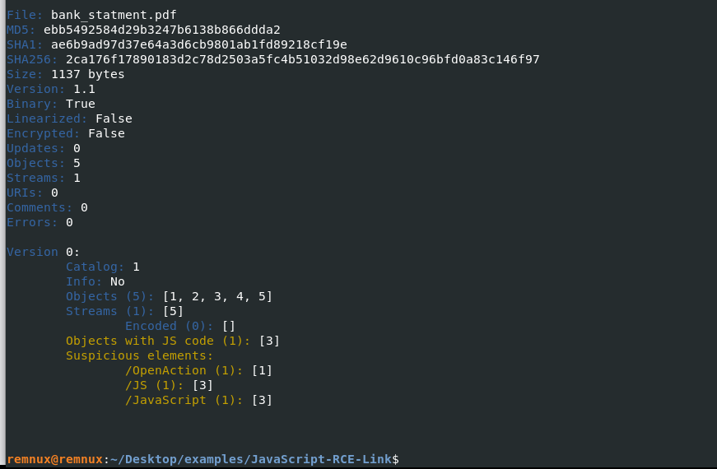

Slide 26
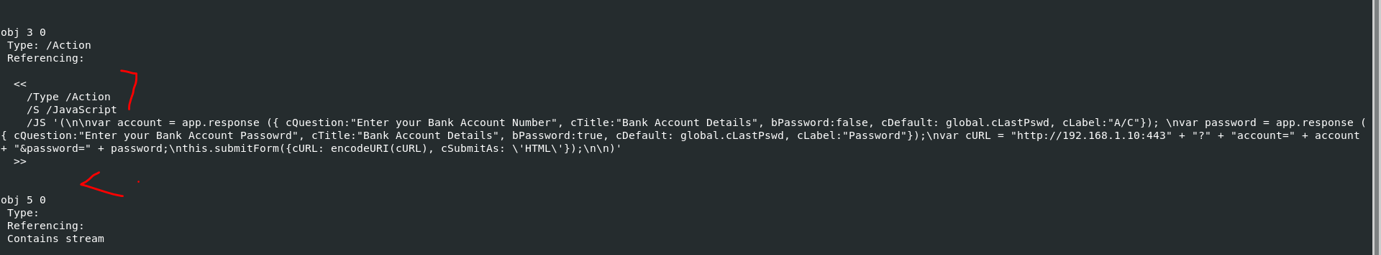
Java Script #Pdf-parser bank_statement.pdf

Slide 27
What To Look for ; Static Analysis
/OpenAction /AA specifies the script or action to run automatically.
/Names /AcroForm /Action can also specify and launch scripts or actions. /JavaScript specifies JavaScript to run.
/GoTo changes the view to a specified destination within the PDF or in another PDF file.
/Launch a program or opens a document.
/URI accesses a resource by its URL.
/SubmitForm /GoToR can send data to URL.
/RichMedia can be used to embed Flash in PDF.
/ObjStm can hide objects inside an Object Stream.
/JavaScript > /J#61vaScript Beware on obfuscation technique with hex codes

Slide 28
Digital Signature – To Protect PDF Files
Security in Portable Electronic documents (PDF)
Integrity ; A digest is computed over a range of bytes from the file.
Byte Range is hashed and signed using the private key of the sender.
The sender's Certificate are embedded in the PDF (detached signing )

Slide 29
PAdES implementation (PDF Advanced Electronic Signatures)
A set of restrictions and extensions to PDF and ISO 32000-1
PAdES ETSI_TS_102_778: is the new standard for PDF signatures. It's based on CAdES, but very limited, so that the standards do not have much in common –
PAdES – LTV ; long term validation
Requires Document security store (DSS) and Document Timestamp
A new DSS+TS are added before expiration of the last document timestamp

Slide 30
Protecting Portable Document – PDF
Digital Signature – To apply integrity on the file:
Generate a signature field
- Generate a signature dictionary (Generate a PDF object and define Byte Range.)
- Calculate the signature value, generate PKCS#7 and embed it into the signature dictionary

Slide 31
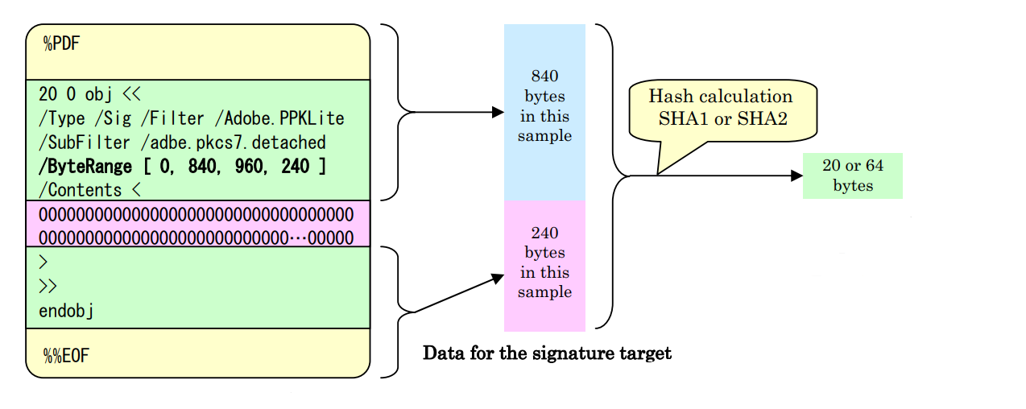

Slide 32
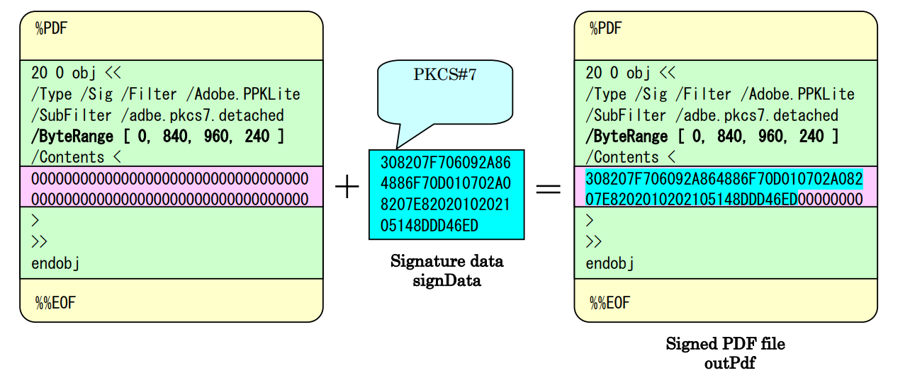
Digital signature field Contd…
The PDF Signature binary value is placed into the Contents entry of the signature dictionary.

Slide 33
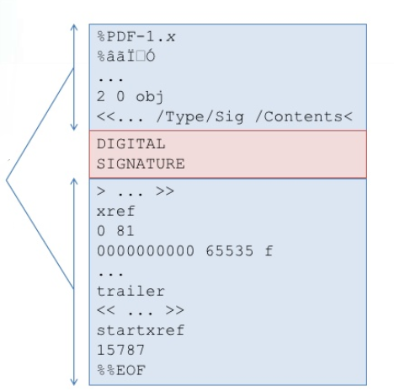
Embedded Digital Signature
The digital signature isn't part ByteRange.
There are no bytes in the PDF that aren't covered other than the PDF signature itself.

Slide 34
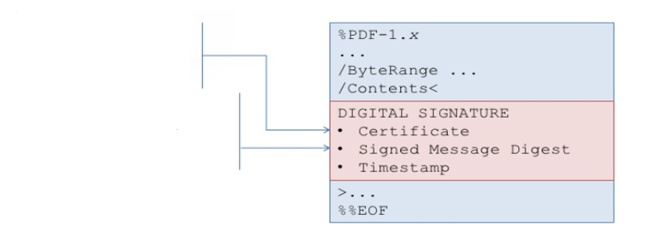
Certificate
Public Key
Identity info
Hash of the document
ByteRange

Slide 35
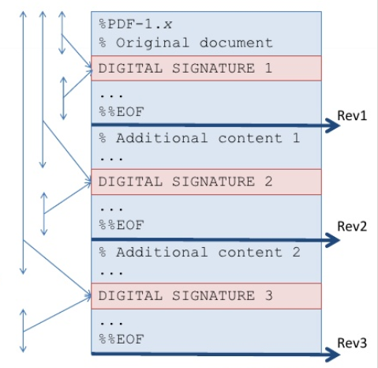
Multiple Signature
Digital signatures are part of the file structure:
Digital signatures are listed in the signature panel.
A PDF document can be signed more than once, but parallel signatures aren't supported, only serial signatures sign all previous signatures.

Slide 36
PAdES implementation (PDF Advanced Electronic Signatures)
A set of restrictions and extensions to PDF and ISO 32000-1
PAdES ETSI_TS_102_778: is the new standard for PDF signatures. It's based on CAdES, but very limited, so that the standards do not have much in common –
PAdES – LTV ; long term validation
Requires Document security store (DSS) and Document Timestamp
A new DSS+TS are added before expiration of the last document timestamp

Slide 37
Summary
detaching existing XML response contain PKCs7 signature to a pdf file
the way PAdES implementation which for signature panel creation we will add signing time , reason , signing Name , co-ordinates. So all these parameters will be added to panel on the PDF and then the Hash generation takes place. All of these need to be in the same session.

Slide 38
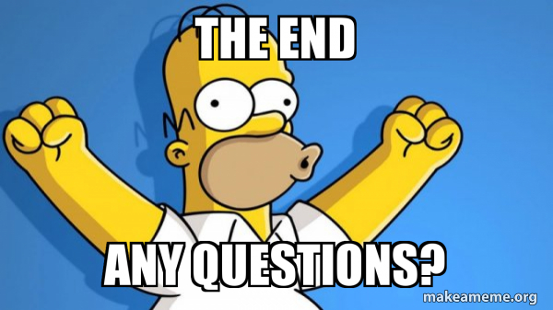

Slide 39
References:
https://en.wikipedia.org/wiki/List_of_file_signatures
https://raw.githubusercontent.com/zbetcheckin/PDF_analysis/master/pdf_ange_albertini.png
https://speakerdeck.com/ange/lets-write-a-pdf-file
https://github.com/0xCyberY/CVE-T4PDF#List-of-CVEs
http://binvis.io/#/
https://github.com/VirusTotal/yara

Slide 40
Thank You

